Slide 1
Machine Comprehension using Neural Network Models
Jing Jiang
School of Information Systems
Singapore Management University

Slide 2
Singapore Management University
Accountancy
Business
Economics
Information Systems
Law
Social Sciences

Slide 3
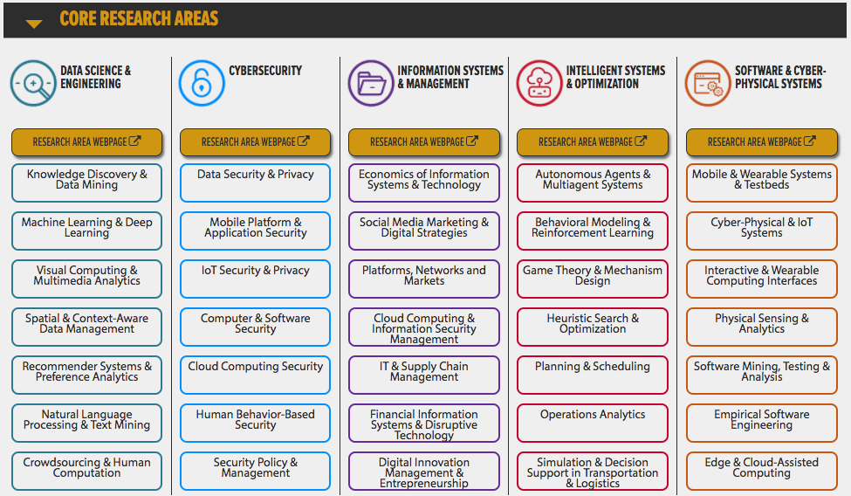
School of Information Systems

Slide 4
Outline
What is machine comprehension?
Recent benchmark datasets
Neural network-based solutions
Match-LSTM for sequence matching [Wang & Jiang, NAACL’16]
Match-LSTM + PointerNetwork [Wang & Jiang, ICLR’17]
Challenges

Slide 5
What Is Machine Comprehension?
In 1870, Tesla moved to Karlovac, to attend school at the Higher Real Gymnasium, where he was profoundly influenced by a math teacher Martin Sekulic ́. The classes were held in German, as it was a school within the Austro-Hungarian Military Frontier. Tesla was able to perform integral calculus in his head, which prompted his teachers to believe that he was cheating. He finished a four-year term in three years, graduating in 1873.
In what language were the classes given? German
Who was Tesla’s main influence in Karlovac? Martin Sekulic ́
Why did Tesla go to Karlovac? attend school at the Higher Real Gymnasium

Slide 6
What Is Machine Comprehension?
In 1870, Tesla moved to Karlovac, to attend school at the Higher Real Gymnasium, where he was profoundly influenced by a math teacher Martin Sekulic ́. The classes were held in German, as it was a school within the Austro-Hungarian Military Frontier. Tesla was able to perform integral calculus in his head, which prompted his teachers to believe that he was cheating. He finished a four-year term in three years, graduating in 1873.
In what language were the classes given? German
Who was Tesla’s main influence in Karlovac? Martin Sekulic ́
Why did Tesla go to Karlovac? attend school at the Higher Real Gymnasium

Slide 7
Machine Reading Comprehension
To train machines to answer questions related to a given piece of text

Slide 8
Previous Work
Machine reading comprehension is not new
E.g., “Deep Read: A Reading Comprehension System”, Hirschman et al. (ACL 1999)
“Our system represents the information content of a sentence (both question and text sentences) as the set of words in the sentence. The word sets are considered to have no structure or order…The search subtask consists of finding the best match between the word set representing the question and the sets representing sentences in the document.”
TREC QA track
Earlier work was not based on neural network models, and earlier datasets were relatively small

Slide 9
Recent Benchmark Datasets
Growing interest in applying neural network models for machine comprehension
Several large-scale datasets have been introduced to the community
CNN/Daily Mail
Children’s Book Test (CBT)
Stanford Questions Answering Dataset (SQuAD)

Slide 10
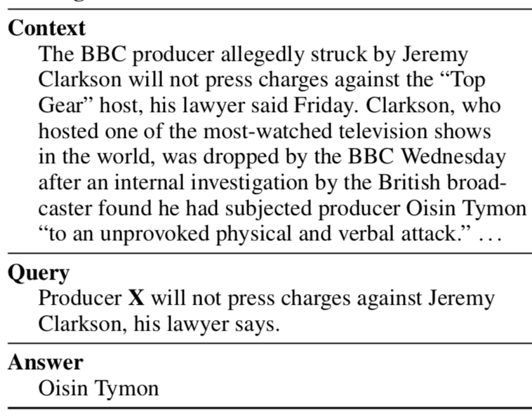
Cloze-style Datasets
What is a cloze-style dataset?
(Example below taken from [Hermannn et al. 2015])
A given summary point of the news article
Question-answer pairs can be automatically generated fairly easily.

Slide 11
CNN/Daily Mail [Hermannn et al. 2015]
93,000 articles from CNN
220,000 articles from Daily Mail
Articles came with summary bullet points
To form cloze-style questions, replaced entities with X
 | training | validation | test
CNN | 380,298 | 3,924 | 3,198
Daily Mail | 879,450 | 64,835 | 53,182

Slide 12
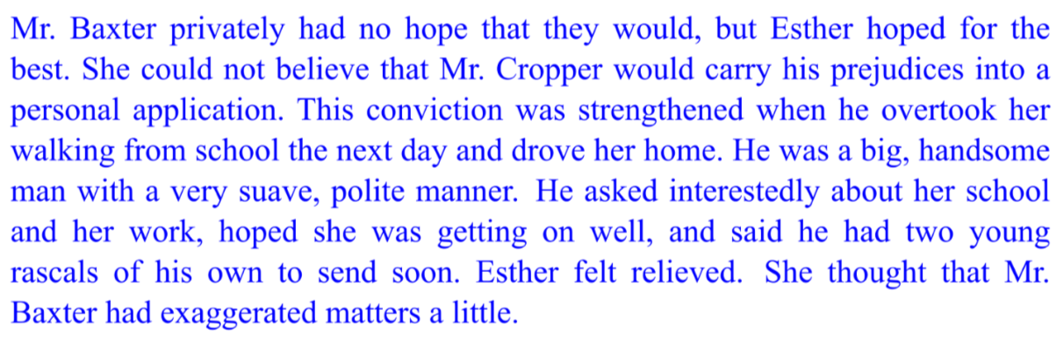
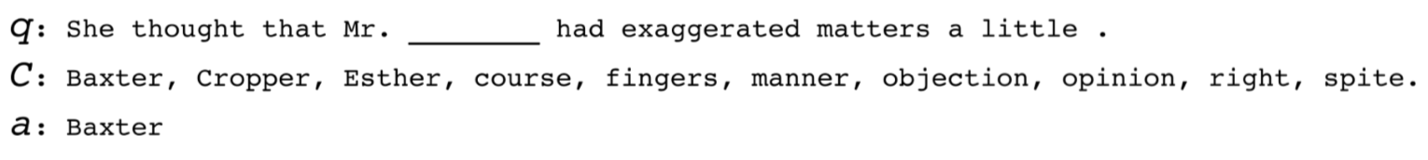
Children’s Book Test [Hill et al. 2016]
21 consecutive sentences from a children’s book
Hide a word from the 21st sentence to form a question
(Example above taken from [Hill et al. 2016])

Slide 13
Children’s Book Test (CBT)
Statistics of the CBT dataset:
training | validation | test
669,343 | 8,000 | 10,000

Slide 14
SQuAD [Rajpurkar et al., 2016]
Articles taken from Wikipedia
Questions-answer pairs generated through crowdsourcing
Compared with cloze-style questions, these questions are more realistic

Slide 15
SQuAD
In total, 107,787 question-answer pairs from 536 articles.
Compared with other large-scale RC datasets, SQuAD was manually created.

Slide 16
Some Observations
In 1870, Tesla moved to Karlovac, to attend school at the Higher Real Gymnasium, where he was profoundly influenced by a math teacher Martin Sekulic ́. The classes were held in German, as it was a school within the Austro-Hungarian Military Frontier. Tesla was able to perform integral calculus in his head, which prompted his teachers to believe that he was cheating. He finished a four-year term in three years, graduating in 1873.
In what language were the classes given? German
Who was Tesla’s main influence in Karlovac? Martin Sekulic ́
Why did Tesla go to Karlovac? attend school at the Higher Real Gymnasium

Slide 17
Some Observations
The local contexts of the correct answer strings can often be matched with the questions.
Semantic matching is important sometimes.
given → held
go → moved

Slide 18
Solution
One way to solve machine comprehension is to treat it as a sequence matching problem.
The idea resembles old solutions to reading comprehension
“The search subtask consists of finding the best match between the word set representing the question and the sets representing sentences in the document.” [Hirschman et al. 1999]
Advantages of neural sequence matching
Word embeddings can encode semantic meanings
RNN models can encode contextual information

Slide 19
Outline
What is machine comprehension?
Recent benchmark datasets
Neural network-based solutions
Match-LSTM for sequence matching [Wang & Jiang, NAACL’16]
Match-LSTM + PointerNetwork [Wang & Jiang, ICLR’17]
Challenges

Slide 20
Sequence Matching
A dog jumping for a Frisbee in the snow.
An animal is outside in the cold weather, playing with a plastic toy.

Slide 21
Sequence Matching
A dog jumping for a Frisbee in the snow.
An animal is outside in the cold weather, playing with a plastic toy.

Slide 22
Sequence Matching
A dog jumping for a Frisbee in the snow.
An animal is outside in the cold weather, playing with a plastic toy.

Slide 23
Sequence Matching
A dog jumping for a Frisbee in the snow.
An animal is outside in the cold weather, playing with a plastic toy.

Slide 24
Sequence Matching
A dog jumping for a Frisbee in the snow.
An animal is outside in the cold weather, playing with a plastic toy.

Slide 25
Sequence Matching
A neural network-based sequence matching model can automatically align the two sequences.
A dog jumping for a Frisbee in the snow.
An animal is outside in the cold weather, playing with a plastic toy.

Slide 26

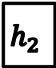
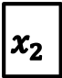



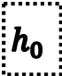
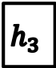

Background: LSTM
hidden states
$$h_{0}$$
$$h_{1}$$
$$h_{2}$$
$$h_{3}$$
$$h_{N}$$
…
word embeddings
$$x_{1}$$
$$x_{2}$$
$$x_{3}$$
…
$$x_{N}$$
original sentence
a
dog
jumping
snow
vector encoding the entire sentence, used for sentence-level classification

Slide 27
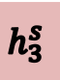



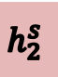









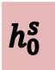




Bowman et al.
jumping
snow
Seq 1
$$x_{1}^{s}$$
$$x_{2}^{s}$$
$$x_{3}^{s}$$
$$x_{M}^{s}$$
…
$$h_{0}^{s}$$
$$h_{1}^{s}$$
$$h_{2}^{s}$$
$$h_{3}^{s}$$
…
$$h_{M}^{s}$$
$$h^{∗}$$
$$h_{0}^{t}$$
$$h_{1}^{t}$$
$$h_{2}^{t}$$
$$h_{3}^{t}$$
$$h_{N}^{t}$$
…
Seq 2
$$x_{1}^{t}$$
$$x_{2}^{t}$$
$$x_{3}^{t}$$
…
$$x_{N}^{t}$$
an
animal
is
toy

Slide 28
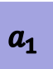


Rockt$\ddot{a}$schel et al.
jumping
snow
Seq 1
$$x_{1}^{s}$$
$$x_{2}^{s}$$
$$x_{3}^{s}$$
$$x_{M}^{s}$$
…
$$h_{0}^{s}$$
$$h_{1}^{s}$$
$$h_{2}^{s}$$
$$h_{3}^{s}$$
…
$$h_{M}^{s}$$
Attention-weighted Seq 1
$$a_{1}$$
RNN
$$h_{1}^{a}$$
$$h_{0}^{t}$$
$$h_{1}^{t}$$
$$h_{2}^{t}$$
$$h_{3}^{t}$$
$$h_{N}^{t}$$
…
Seq 2
$$x_{1}^{t}$$
$$x_{2}^{t}$$
$$x_{3}^{t}$$
…
$$x_{N}^{t}$$
an
animal
is
toy

Slide 29
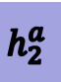
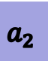
Rockt$\ddot{a}$schel et al.
Seq 1
$$x_{1}^{s}$$
$$x_{2}^{s}$$
$$x_{3}^{s}$$
$$x_{M}^{s}$$
…
$$h_{0}^{s}$$
$$h_{1}^{s}$$
$$h_{2}^{s}$$
$$h_{3}^{s}$$
…
$$h_{M}^{s}$$
Attention-weighted Seq 1
$$a_{1}$$
$$a_{2}$$
RNN
$$h_{1}^{a}$$
$$h_{2}^{a}$$
$$h_{0}^{t}$$
$$h_{1}^{t}$$
$$h_{2}^{t}$$
$$h_{3}^{t}$$
$$h_{N}^{t}$$
…
Seq 2
$$x_{1}^{t}$$
$$x_{2}^{t}$$
$$x_{3}^{t}$$
…
$$x_{N}^{t}$$
an
animal
is
toy

Slide 30
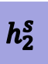




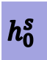

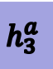

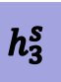
Rockt$\ddot{a}$schel et al.
jumping
snow
Seq 1
$$x_{1}^{s}$$
$$x_{2}^{s}$$
$$x_{3}^{s}$$
$$x_{M}^{s}$$
…
$$h_{0}^{s}$$
$$h_{1}^{s}$$
$$h_{2}^{s}$$
$$h_{3}^{s}$$
…
$$h_{M}^{s}$$
Attention-weighted Seq 1
$$a_{1}$$
$$a_{2}$$
$$a_{3}$$
…
$$a_{N}$$
RNN
$$h_{1}^{a}$$
$$h_{2}^{a}$$
$$h_{3}^{a}$$
$$h_{N}^{a}$$
$$h^{∗}$$
$$h_{0}^{t}$$
$$h_{1}^{t}$$
$$h_{2}^{t}$$
$$h_{3}^{t}$$
$$h_{N}^{t}$$
…
Seq 2
$$x_{1}^{t}$$
$$x_{2}^{t}$$
$$x_{3}^{t}$$
…
$$x_{N}^{t}$$
an
animal
is
toy

Slide 31
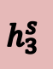




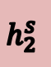




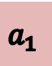









Match-LSTM
$$x_{1}^{s}$$
$$x_{2}^{s}$$
$$x_{3}^{s}$$
$$x_{M}^{s}$$
…
Seq 1
$$h_{0}^{s}$$
$$h_{1}^{s}$$
$$h_{2}^{s}$$
$$h_{3}^{s}$$
…
$$h_{M}^{s}$$
Attention-weighted Seq 1
$$a_{1}$$
$$h_{0}^{t}$$
$$h_{1}^{t}$$
$$h_{2}^{t}$$
$$h_{3}^{t}$$
$$h_{N}^{t}$$
…
Seq 2
$$x_{1}^{t}$$
$$x_{2}^{t}$$
$$x_{3}^{t}$$
…
$$x_{N}^{t}$$
$$h_{1}^{m}$$
Match-LSTM

Slide 32
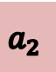

Match-LSTM
$$x_{1}^{s}$$
$$x_{2}^{s}$$
$$x_{3}^{s}$$
$$x_{M}^{s}$$
…
Seq 1
$$h_{0}^{s}$$
$$h_{1}^{s}$$
$$h_{2}^{s}$$
$$h_{3}^{s}$$
…
$$h_{M}^{s}$$
Attention-weighted Seq 1
$$a_{1}$$
$$a_{2}$$
$$h_{0}^{t}$$
$$h_{1}^{t}$$
$$h_{2}^{t}$$
$$h_{3}^{t}$$
$$h_{N}^{t}$$
…
Seq 2
$$x_{1}^{t}$$
$$x_{2}^{t}$$
$$x_{3}^{t}$$
…
$$x_{N}^{t}$$
$$h_{1}^{m}$$
$$h_{2}^{m}$$
Match-LSTM

Slide 33





Match-LSTM
$$x_{1}^{s}$$
$$x_{2}^{s}$$
$$x_{3}^{s}$$
$$x_{M}^{s}$$
…
Seq 1
$$h_{0}^{s}$$
$$h_{1}^{s}$$
$$h_{2}^{s}$$
$$h_{3}^{s}$$
…
$$h_{M}^{s}$$
Attention-weighted Seq 1
$$a_{1}$$
$$a_{2}$$
$$a_{3}$$
…
$$a_{N}$$
$$h_{0}^{t}$$
$$h_{1}^{t}$$
$$h_{2}^{t}$$
$$h_{3}^{t}$$
$$h_{N}^{t}$$
…
prediction
Seq 2
$$x_{1}^{t}$$
$$x_{2}^{t}$$
$$x_{3}^{t}$$
…
$$x_{N}^{t}$$
$$h_{1}^{m}$$
$$h_{2}^{m}$$
$$h_{3}^{m}$$
$$h_{N}^{m}$$
Match-LSTM
33

Slide 34
Outline
What is machine comprehension?
Recent benchmark datasets
Neural network-based solutions
Match-LSTM for sequence matching [Wang & Jiang, NAACL’16]
Match-LSTM + PointerNetwork [Wang & Jiang, ICLR’17]
Challenges

Slide 35
Machine Comprehension
Neural layer for reasoning the matched word pairs
attend school at the Higher Real Gymnasium
In 1870, Tesla moved to Karlovac, to attend school at the Higher Real Gymnasium,
NULL
Tesla
go
Karlovac
why
NULL
Why did Tesla go to Karlovac ? NULL

Slide 36












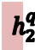



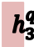


Match-LSTM + PtrNet
LSTM / Bi-LSTM preprocessing Layer for Passage
$$..$$
$$h_{10}^{p}$$
$$h_{11}^{p}$$
$$..$$
$$h_{15}^{p}$$
$$h_{16}^{p}$$
$$..$$
attend
school
Real
Gymnasium
$$..$$
$${\overline{h}}_{10}^{q}$$
$${\overline{h}}_{11}^{q}$$
$$..$$
$${\overline{h}}_{15}^{q}$$
$${\overline{h}}_{16}^{q}$$
$$..$$
soft attention
+
LSTM / Bi-LSTM preprocessing Layer for Question
$$h_{1}^{q}$$
$$h_{2}^{q}$$
$$h_{3}^{q}$$
$$..$$
$$h_{Q}^{q}$$
Why
did
Tesla
?

Slide 37














Match-LSTM + PtrNet
$$..$$
$${\overset{⃖}{h}}_{10}^{r}$$
$${\overset{⃖}{h}}_{11}^{r}$$
$$..$$
$${\overset{⃖}{h}}_{15}^{r}$$
$${\overset{⃖}{h}}_{16}^{r}$$
$$..$$
Zero
Pad
Match-LSTM
Layer
$$..$$
$${\vec{h}}_{10}^{r}$$
$${\vec{h}}_{11}^{r}$$
$$..$$
$${\vec{h}}_{15}^{r}$$
$${\vec{h}}_{16}^{r}$$
$$..$$
P+1
LSTM / Bi-LSTM preprocessing Layer for Passage
$$..$$
$$h_{10}^{p}$$
$$h_{11}^{p}$$
$$..$$
$$h_{15}^{p}$$
$$h_{16}^{p}$$
$$..$$
attend
school
Real
Gymnasium
$$..$$
$${\overline{h}}_{10}^{q}$$
$${\overline{h}}_{11}^{q}$$
$$..$$
$${\overline{h}}_{15}^{q}$$
$${\overline{h}}_{16}^{q}$$
$$..$$
soft attention
+
LSTM / Bi-LSTM preprocessing Layer for Question
$$h_{1}^{q}$$
$$h_{2}^{q}$$
$$h_{3}^{q}$$
$$..$$
$$h_{Q}^{q}$$
Why
did
Tesla
?

Slide 38

Match-LSTM + PtrNet
Answer Pointer Layer
$$h_{0}^{a}$$
$$..$$
$${\overset{⃖}{h}}_{10}^{r}$$
$${\overset{⃖}{h}}_{11}^{r}$$
$$..$$
$${\overset{⃖}{h}}_{15}^{r}$$
$${\overset{⃖}{h}}_{16}^{r}$$
$$..$$
Zero
Pad
Match-LSTM
Layer
$$..$$
$${\vec{h}}_{10}^{r}$$
$${\vec{h}}_{11}^{r}$$
$$..$$
$${\vec{h}}_{15}^{r}$$
$${\vec{h}}_{16}^{r}$$
$$..$$
P+1
LSTM / Bi-LSTM preprocessing Layer for Passage
$$..$$
$$h_{10}^{p}$$
$$h_{11}^{p}$$
$$..$$
$$h_{15}^{p}$$
$$h_{16}^{p}$$
$$..$$
attend
school
Real
Gymnasium
$$..$$
$${\overline{h}}_{10}^{q}$$
$${\overline{h}}_{11}^{q}$$
$$..$$
$${\overline{h}}_{15}^{q}$$
$${\overline{h}}_{16}^{q}$$
$$..$$
soft attention
+
LSTM / Bi-LSTM preprocessing Layer for Question
$$h_{1}^{q}$$
$$h_{2}^{q}$$
$$h_{3}^{q}$$
$$..$$
$$h_{Q}^{q}$$
Why
did
Tesla
?
(a) Sequence Model

Slide 39

Match-LSTM + PtrNet
Answer Pointer Layer
$$h_{0}^{a}$$
$$h_{1}^{a}$$
$$..$$
$${\overset{⃖}{h}}_{10}^{r}$$
$${\overset{⃖}{h}}_{11}^{r}$$
$$..$$
$${\overset{⃖}{h}}_{15}^{r}$$
$${\overset{⃖}{h}}_{16}^{r}$$
$$..$$
Zero
Pad
Match-LSTM
Layer
$$..$$
$${\vec{h}}_{10}^{r}$$
$${\vec{h}}_{11}^{r}$$
$$..$$
$${\vec{h}}_{15}^{r}$$
$${\vec{h}}_{16}^{r}$$
$$..$$
P+1
LSTM / Bi-LSTM preprocessing Layer for Passage
$$..$$
$$h_{10}^{p}$$
$$h_{11}^{p}$$
$$..$$
$$h_{15}^{p}$$
$$h_{16}^{p}$$
$$..$$
attend
school
Real
Gymnasium
$$..$$
$${\overline{h}}_{10}^{q}$$
$${\overline{h}}_{11}^{q}$$
$$..$$
$${\overline{h}}_{15}^{q}$$
$${\overline{h}}_{16}^{q}$$
$$..$$
soft attention
+
LSTM / Bi-LSTM preprocessing Layer for Question
$$h_{1}^{q}$$
$$h_{2}^{q}$$
$$h_{3}^{q}$$
$$..$$
$$h_{Q}^{q}$$
Why
did
Tesla
?
(a) Sequence Model

Slide 40






Match-LSTM + PtrNet
Answer Pointer Layer
$$h_{0}^{a}$$
$$h_{1}^{a}$$
$$..$$
$$h_{5}^{a}$$
$$h_{5}^{a}$$
$$h_{6}^{a}$$
$$..$$
$$..$$
$$..$$
$${\overset{⃖}{h}}_{10}^{r}$$
$${\overset{⃖}{h}}_{11}^{r}$$
$$..$$
$${\overset{⃖}{h}}_{15}^{r}$$
$${\overset{⃖}{h}}_{16}^{r}$$
$$..$$
Zero
Pad
Match-LSTM
Layer
$$..$$
$${\vec{h}}_{10}^{r}$$
$${\vec{h}}_{11}^{r}$$
$$..$$
$${\vec{h}}_{15}^{r}$$
$${\vec{h}}_{16}^{r}$$
$$..$$
P+1
LSTM / Bi-LSTM preprocessing Layer for Passage
$$..$$
$$h_{10}^{p}$$
$$h_{11}^{p}$$
$$..$$
$$h_{15}^{p}$$
$$h_{16}^{p}$$
$$..$$
attend
school
Real
Gymnasium
$$..$$
$${\overline{h}}_{10}^{q}$$
$${\overline{h}}_{11}^{q}$$
$$..$$
$${\overline{h}}_{15}^{q}$$
$${\overline{h}}_{16}^{q}$$
$$..$$
soft attention
+
LSTM / Bi-LSTM preprocessing Layer for Question
$$h_{1}^{q}$$
$$h_{2}^{q}$$
$$h_{3}^{q}$$
$$..$$
$$h_{Q}^{q}$$
Why
did
Tesla
?
(a) Sequence Model

Slide 41
Match-LSTM + PtrNet
Answer Pointer Layer
$$h_{0}^{a}$$
$$..$$
$${\overset{⃖}{h}}_{10}^{r}$$
$${\overset{⃖}{h}}_{11}^{r}$$
$$..$$
$${\overset{⃖}{h}}_{15}^{r}$$
$${\overset{⃖}{h}}_{16}^{r}$$
$$..$$
Zero
Pad
Match-LSTM
Layer
$$..$$
$${\vec{h}}_{10}^{r}$$
$${\vec{h}}_{11}^{r}$$
$$..$$
$${\vec{h}}_{15}^{r}$$
$${\vec{h}}_{16}^{r}$$
$$..$$
P+1
LSTM / Bi-LSTM preprocessing Layer for Passage
$$..$$
$$h_{10}^{p}$$
$$h_{11}^{p}$$
$$..$$
$$h_{15}^{p}$$
$$h_{16}^{p}$$
$$..$$
attend
school
Real
Gymnasium
$$..$$
$${\overline{h}}_{10}^{q}$$
$${\overline{h}}_{11}^{q}$$
$$..$$
$${\overline{h}}_{15}^{q}$$
$${\overline{h}}_{16}^{q}$$
$$..$$
soft attention
+
LSTM / Bi-LSTM preprocessing Layer for Question
$$h_{1}^{q}$$
$$h_{2}^{q}$$
$$h_{3}^{q}$$
$$..$$
$$h_{Q}^{q}$$
Why
did
Tesla
?
(b) Boundary Model

Slide 42
Match-LSTM + PtrNet
Answer Pointer Layer
$$h_{0}^{a}$$
$$h_{1}^{a}$$
$$..$$
$${\overset{⃖}{h}}_{10}^{r}$$
$${\overset{⃖}{h}}_{11}^{r}$$
$$..$$
$${\overset{⃖}{h}}_{15}^{r}$$
$${\overset{⃖}{h}}_{16}^{r}$$
$$..$$
Zero
Pad
Match-LSTM
Layer
$$..$$
$${\vec{h}}_{10}^{r}$$
$${\vec{h}}_{11}^{r}$$
$$..$$
$${\vec{h}}_{15}^{r}$$
$${\vec{h}}_{16}^{r}$$
$$..$$
P+1
LSTM / Bi-LSTM preprocessing Layer for Passage
$$..$$
$$h_{10}^{p}$$
$$h_{11}^{p}$$
$$..$$
$$h_{15}^{p}$$
$$h_{16}^{p}$$
$$..$$
attend
school
Real
Gymnasium
$$..$$
$${\overline{h}}_{10}^{q}$$
$${\overline{h}}_{11}^{q}$$
$$..$$
$${\overline{h}}_{15}^{q}$$
$${\overline{h}}_{16}^{q}$$
$$..$$
soft attention
+
LSTM / Bi-LSTM preprocessing Layer for Question
$$h_{1}^{q}$$
$$h_{2}^{q}$$
$$h_{3}^{q}$$
$$..$$
$$h_{Q}^{q}$$
Why
did
Tesla
?
(b) Boundary Model

Slide 43
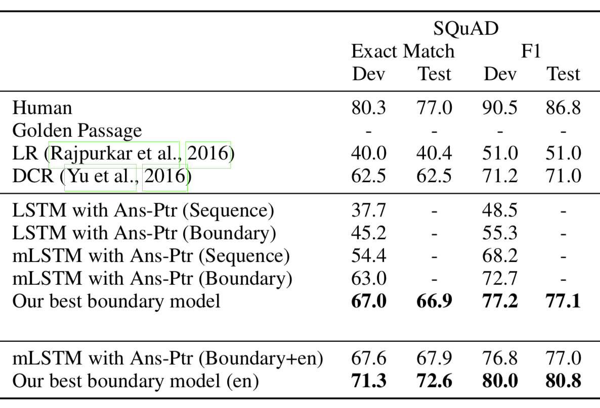
Results on SQuAD

Slide 44
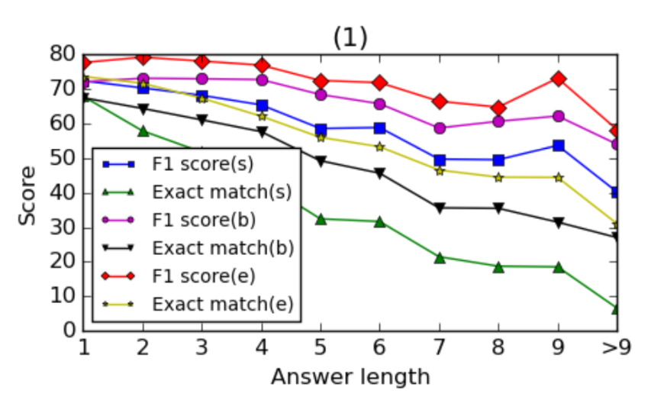
Breakdown by Answer Length

Slide 45
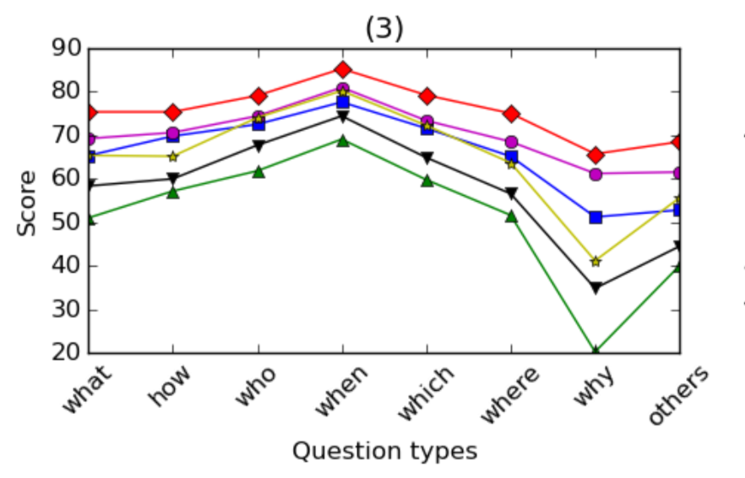
Breakdown by Question Type

Slide 46
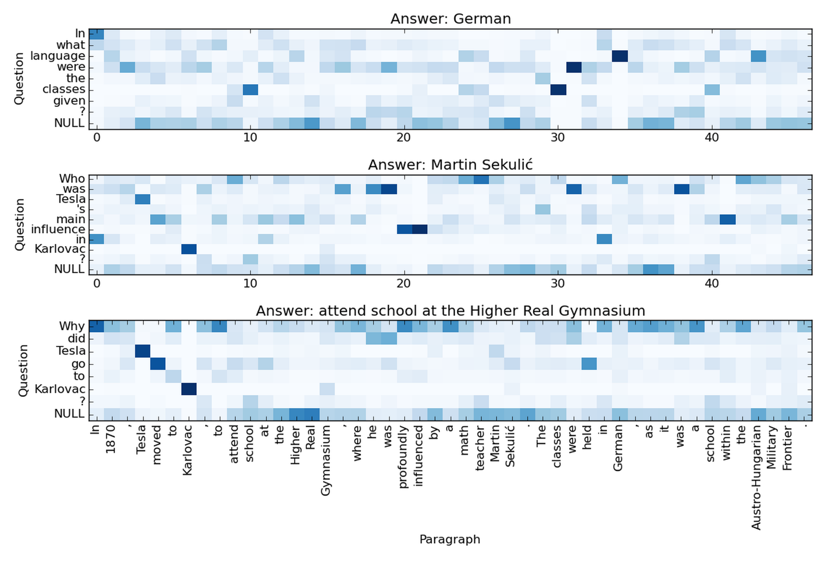
Sample Matching Results

Slide 47
Sample Matching Results
language
German

Slide 48
Sample Matching Results
influence
profoundly influenced

Slide 49
Examples of Some Other Models
DCN (Dynamic Coattention Networks) by Salesforce Research
BiDAF (Bi-Directional Attention Flow) by Allen Institute for AI & University of Washington
Gated Self-Matching Networks by Microsoft Research Asia

Slide 50
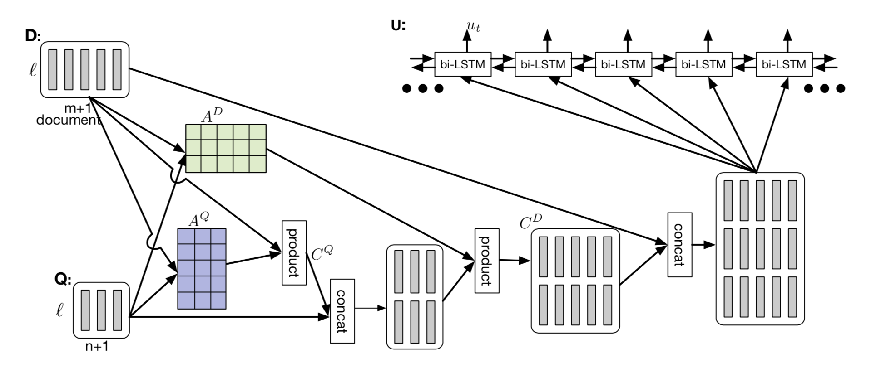
Dynamic Coattention Networks [Xiong et al. 2017]
by Salesforce Research
prediction of start and end
attention
matching

Slide 51
Dynamic Coattention Networks [Xiong et al. 2017]
The attention mechanism is two-way
Attention-weighted sum of question for each document word
Attention-weighted sum of document for each question word
An iterative procedure to predict start and end points

Slide 52
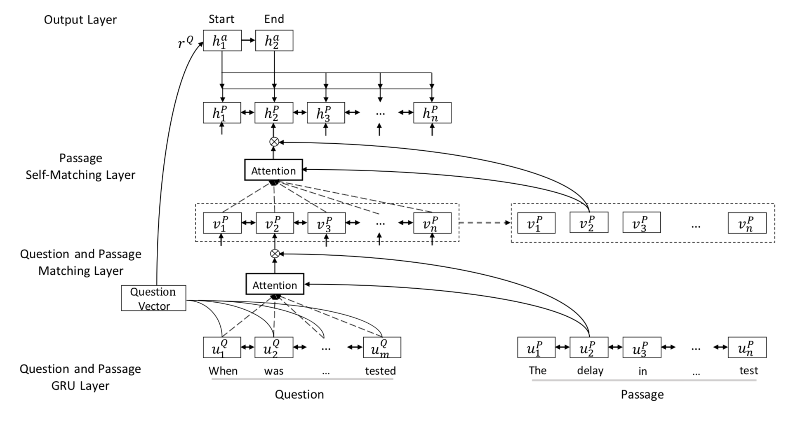
Gated Self-Matching Networks [Wang et al. 2017]
by Microsoft Research Asia

Slide 53
Outline
What is machine comprehension?
Recent benchmark datasets
Neural network-based solutions
Match-LSTM for sequence matching [Wang & Jiang, NAACL’16]
Match-LSTM + PointerNetwork [Wang & Jiang, ICLR’17]
Challenges

Slide 54
Limitations and Challenges
These sequence-matching based models are good at finding answers whose contexts in the document match the questions well.
For questions that require inference or summarization, these models may not work well.
E.g., “Which of the following statements is not true?” from the RACE dataset [Lai et al. 2017]
E.g., NarrativeQA dataset [Kocisky et al. 2017]

Slide 55
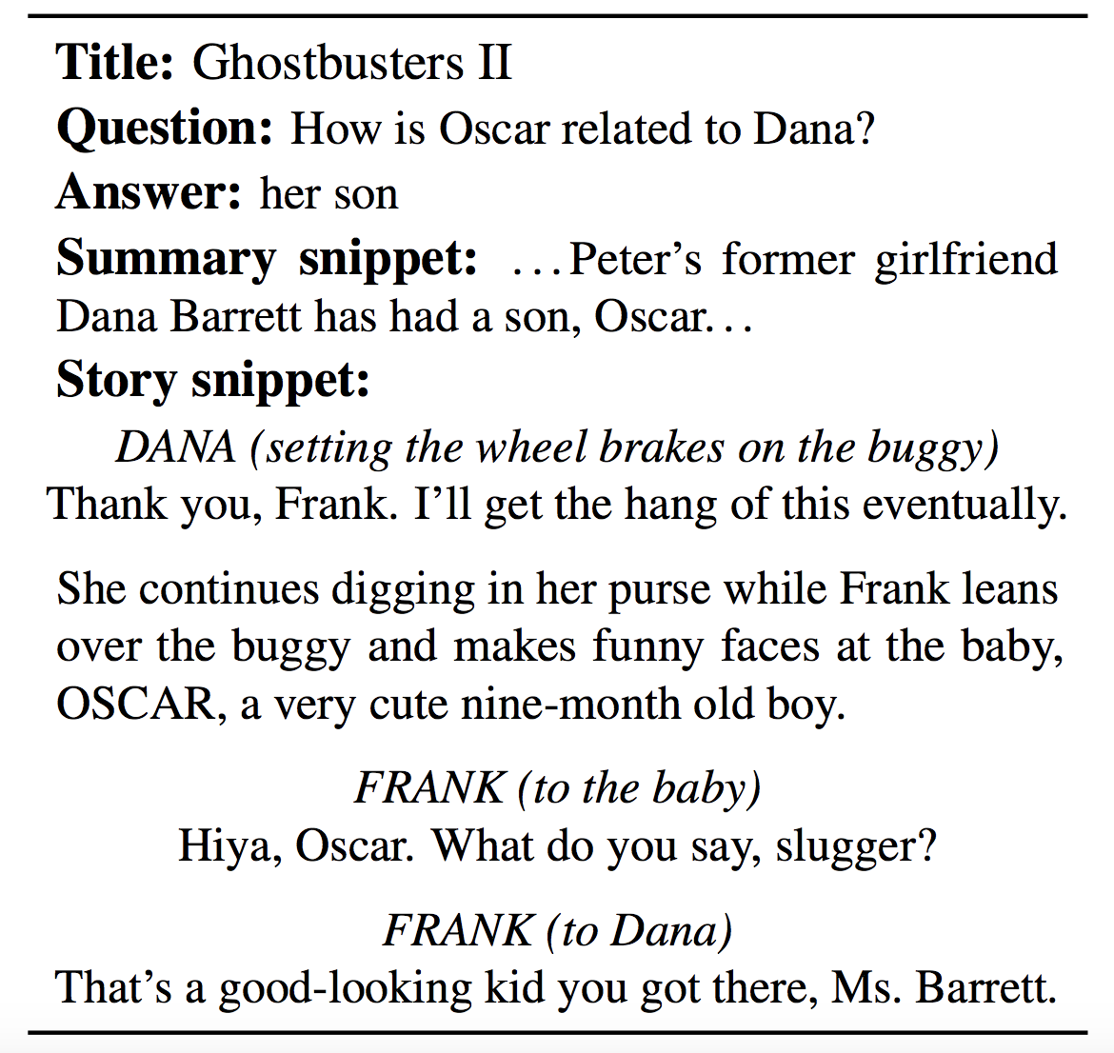
NarrativeQA Dataset [Kocisky et al. 2017]
NOT given to the machine
given to the machine

Slide 56
Limitations and Challenges
Overfitting the training data
May not work well when given a large corpus to read (open-domain question answering)

Slide 57
Conclusions
Machine reading comprehension provides a testbed to evaluate neural network models’ capabilities to understand human language
Existing neural network models for machine comprehension adopt a sequence matching approach with attention mechanisms
The task is far from being solved, despite promising results on some datasets

Slide 58
Acknowledgment
Joint work with Shuohang Wang

